Slide 1
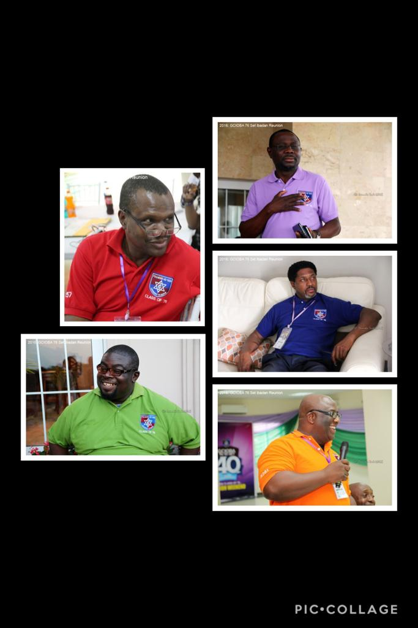
Preparing for the future
A Roadmap

Slide 2
Agenda
Preamble
Introduction of Executive Council
The journey so far
Objectives for the day
  Constitution
  Budget/Subscription
  Rules and Regulations
  Welfare and Insurance

Slide 3
Preamble
Why we need to Restructure
It’s been nearly 4 years since our extremely memorable reunion in October 2016.
We have all been part of this journey of discovery, natural evolution and mutual appreciation of each other.
The EXCO started an exercise early 2020 to review our operational processes in order to Adapt, Adjust, Adopt our protocols to achieve sustainability for the future.
Recent events have underscored the need to intensify our efforts, highlighted the urgency for a more dynamic and progressive approach to meeting our Social Responsibilities in a sustainable and equitable manner.
We now need your participation, contribution and approval to implement these proposals.
Adjust
Adopt
Adapt

Slide 4
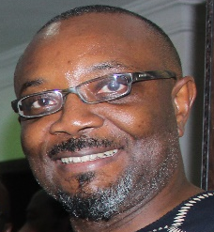
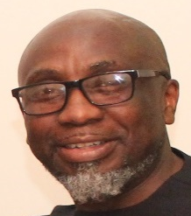
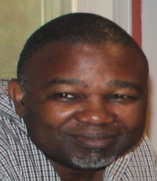
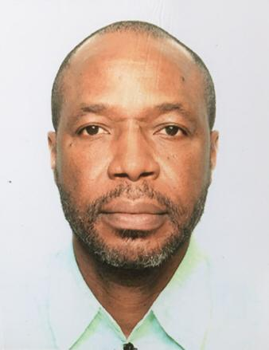
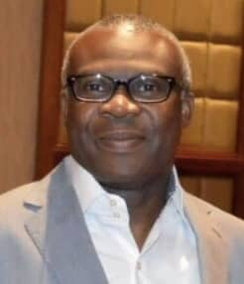
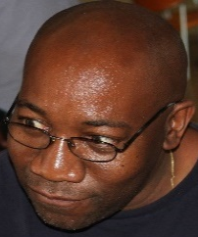
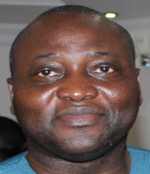
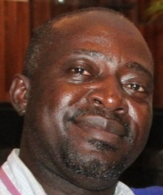
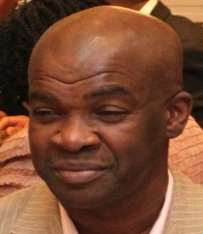
Introduction of
Global GCIOBA 76 Executive Council
Biodun Obileye – President – Nigeria (Global)
Tolu Fayemi – President – Europe
Tunji Taiwo – President – The Americas
Goke Osibodu – Former President (Nigeria)
Ayo Olaoye – General Secretary
Tunde Obrimah – Treasurer
Olumide Ayoola – Communications Officer
Kunle Morohundiya – Legal Adviser
Tito Adebajo – Welfare Officer

Slide 5
Governance
“Previously”
Previously, we have relied solely on the goodwill of our members who have been willing to serve
Ensuring smooth succession and continuity has been the responsibility of the incumbent
This process has largely been by “Acclamation”
This model has served us well across all regions
These changes seek to extend the “opportunity to serve” to all members and does not replace the process of “Acclamation” provided, there is no other candidate AND the incumbent is willing to continue

Slide 6
Governance
“Moving Forward”
We have consulted over the last 2 weeks via short texts on WhatsApp and more recently provided sections of this presentation
The essence of this consultation was to provide you with “advance” view of our deliberations thus far, so that we may avail ourselves of your views, comments, critical discuss and disparate expertise
The hope is that this will result in
  Better engagement with each other
  Mutual respect for each other
  A cohesive plan for our collective future
  Better preparation and attention to our wellbeing
  Operation as a well oiled, more organised unit globally
This is a clarion call for us all consider how we can contribute going forward into the future

Slide 7
Governance
“Moving Forward”
This new process now provides, in a transparent manner, how you can get involved, participate and lead in the smooth running of our association
Do you know how the elective positions are filled?
  Any member of the association in each region may nominate a candidate during the election year
What is the tenure of office?
  Elections are held every 2 years
  The tenure of all elected officials is 2 years
How do you get involved if you want to serve?
  Aside from elective office, there are also appointed roles which the EXCO is responsible for filling. Please contact your Region/Chapter president with availability

Slide 8
Constitution
Name and Headquarters
  GCIOBA 76-81 Set
  Nigeria HQ
  3 Regional groups
AIMS AND OBJECTIVES
  Maintain a close association between members
  Promote and protect the interest, welfare and progress of individual members and the group as a collective
  Commitment to upholding of standards and development of our Alma mata - Government College, Ibadan

Slide 9
Constitution
MEMBERSHIP
  Automatic membership of GCIOBA76
  Variance in member activity levels
  Seeking missing members
  Privilege membership of Group social media platforms

Slide 10
Constitution

Slide 11
Constitution
REGIONAL STRUCTURE
  Africa
  Europe
  Americas
  Regional WhatsApp forums – info and important circulars only
GROUP COMMITTEES
  EXCO powers
  Volunteers
ELECTIONS AND APPOINTEMENTS
  Frequency of elections
  Format of elections
  Nominations of candidates
  Returning unopposed candidates
  Selection of appointed officers
  Disputes

Slide 12
Constitution
VOTING AND TENURE OF OFFICE
  Automatic right to vote for paid up members
  How to vote
  Elected positions
  Tenure of elected officials
  Tenure of appointed officials
  Tenure of committees
MEETINGS
  Frequency
  Venue
  Format
  Mandatory Agenda items
  Mandatory minutes reporting and report circulation

Slide 13
Constitution
FINANCIAL ARRANGEMENT AND REPORTING
  Annual Budget
  Budget Approval
  Banking and Investing
  Financial Reporting
  Annual Dues
RULES AND REGULATIONS
  Code of conduct
  Social Media Forum Rules
  Individual Grievances
DISCIPLINE
  Powers of the EXCO
  Mediation

Slide 14
WELFARE CHARTER
Aims of GCIOBA76 Welfare Charter
Help each other through health, emotional or financial challenges
Provide support to the loved ones of any departed member
Enable members to seek confidential benefit of the various expertise, skills and contacts available within the group
Reduce the need for official ad-hoc donation requests from group members

Slide 15
WELFARE CHARTER
For Members
A support package if you experience defined family bereavements.
A support package if you experience hardship or need.
For your Family
A support package for your family in event of your untimely passing of you or your spouse
Funding avenues for above events
Social Group Collections
Official Group Welfare
Group Insurance

Slide 16
WELFARE CHARTER
Social Group Collections
Average voluntary member contribution this year alone was approx. N45k
Collections this year alone have generated over N5m for about 6 sorrowful events
As we and our parents age, the need for donations will most likely increase
This welfare charter makes donations more of a personal individual social obligation as opposed to a group official obligation placing financial strain on individuals
This social collection will be supplemented by a defined official automatic donation from GCIOBA76 on behalf of ALL members

Slide 17
WELFARE CHARTER
Automatic GCIOBA76 Donations (suggested)**
N250k to member upon death of spouse
N250k to member upon death of member’s parent
N250k to member’s family upon death of member
Amounts above represent a token donation from GCIOBA76 on behalf of ALL members
Social Group Collection efforts comprising GCI and non GCI friends of the member may be run in parallel with the official GCIOBA76 automatic donation. Participation is purely voluntary for members and carries no implied obligation
** Suggested donations will be paid pro-rata based on percentage of dues paid in any year up to a maximum as shown above.

Slide 18
WELFARE CHARTER
Group Welfare Charter – (Being our brothers keepers)
How can we, as a group be there for each and every one of our brother members in times of hardship or need?
Life throws up unexpected problems that are not always purely financial and cannot be resolved by donations
We have all built up professional expertise, life experiences, skills and contacts that may be of vital importance to our brother member. How can we pool our resources for the common good?
Who within the group can we approach as the initial, CONFIDENTIAL source of help or assistance within the group?
How can we collectively build up and maintain a financial fund for extreme immediate member needs?

Slide 19
WELFARE CHARTER
Group Welfare Charter (Contd)
The Welfare officer is the initial point of contact for welfare or hardship matters
The Welfare officer undertakes to provide a highly confidential, impartial and discreet handling of member matters
The Welfare officer is able to call on assistance from other group members, or convene committees comprising other members in order to facilitate resolution of an individuals matter
The Welfare Officer has discretionary authority to set up a “Health and Medical advice” sub group drawing on expertise of other healthcare professionals in the group

Slide 20
WELFARE CHARTER
Group Welfare Charter (Contd)
Membership of our group contains an implicit moral obligation by us all to render assistance whenever and wherever possible, irrespective of our personal relationship with the individual requiring assistance
The Welfare Officer is also a member of EXCO and can therefore enable highest level, inter-regional assistance
The Welfare Officer can recommend payments from the welfare fund in individual cases and his requests will be considered by EXCO on merit and on a case by case basis
Welfare charter is intended to be of unlimited scope – financial, emotional, career, accommodation, etc.

Slide 21
Group Welfare
Any Annual budget surpluses to be rolled over into welfare funds
Members can make donations directly into welfare fund
A provision that is open and available to ALL members

Slide 22
Group Insurance
Policy Highlights
Automatic basic life insurance and critical illness cover for ALL members
Policy can co-exist alongside any other policies member may have
Optional Extras and Add-ons available to members to upgrade their individual policies *
e.g.
  Enhanced Critical Illness
  Funeral benefits
  Inclusion of Spouse
Pay out is made directly to member or members spouse / designated recipient, not GCIOBA76
Cover available until age 65, thereafter renewable under amended individual terms and conditions
* Any selected upgrade , optional extra or add-on will be at member’s cost

Slide 23
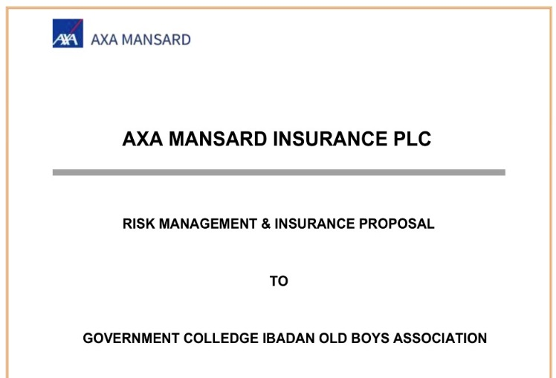
Group Insurance
  Key Insurance information
  Negotiated rates from AXA Mansard Insurance
  Global coverage – open to diaspora members
  Basic coverage automatically provided for all fully paid up members (annual dues) of GCIOBA76
  Paid out in Nigeria irrespective of members residential location
  Payout Currency is Naira only
Basic Coverage*
  Life Insurance Sum Assured - N1m
  Critical Illness Sum Assured - N1m
  Funeral Expenses Sum Assured – N0.5m
  * automatic inclusion only for members paying annual dues

Slide 24
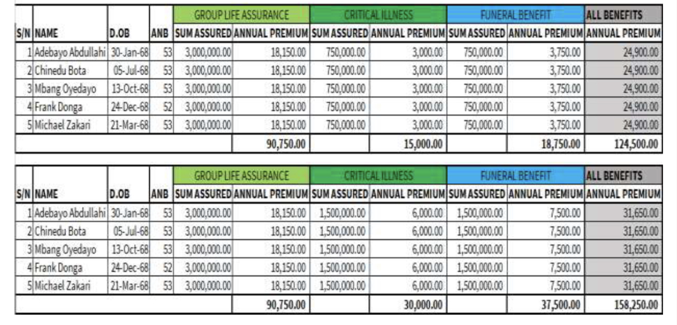
Group Insurance
Examples of optional enhanced cover plus add-ons

Slide 25
Finance
Global Membership
Active / Infrequent
Classification is an analysis of attendance at meetings / contributions
Dormant
This is typically where there is no formal engagement with association

Slide 26
Finance
Budget Proposal

Slide 27
Finance
Analysis and Calculations
Foreign exchange rates are based on a projected average currency rate for Europe and America
Contributor numbers are a broad average calculation of past performance, level of engagement and attendance

